Slide 1
CS 3714 Mobile Software Development
Pebble

Slide 2
Why Should You Care?
You have a homework on Pebble Development
Must include a Pebble Watch App and Android Companion App
Wearables seen as the next big frontier in mobile development
People buy these things ($$$)

Slide 3
Types of Apps
Pebble Watchface
Presents information such as the time, weather, and date
Involves minimal user interaction
Pebble WatchApp
App for the Pebble involving some calculation based on user input
Pebble Companion App paired with WatchApp
Pebble WatchApp that communicates with a smart device
Developer Console Scripting Apps
WatchApp, so customizable has its own scripting language
All development for Pebble watches is in C (yay!)
Except for a little bit of optional Javascript

Slide 4
Application Elements
Pebble apps are event driven
Developers must setup callback functions to be executed on user events
Every main function has the same basic structure
int main() {
init();
app_event_loop();
deinit();
}
init() will contain all the program setup, callbacks, UI elements etc
deinit() will “tear down” things setup in init(), don’t leave anything out
app_event_loop(), infinite loop, allows events to be picked up by listeners

Slide 5
Pebble API in General
All the structs are typedef-ed
Instead of struct Window, we can just type Window (phew)
Functions relating to certain structs are prefixed with the struct name
Ex. window_set_window_handlers deals with Window structs
Ex2. layer_add_child(…) deals with layer structs
Ex3. menu_cell_basic_draw(…) deals with MenuLayer structs

Slide 6
Pebble API in General
The Pebble API is object oriented
What? In C?
Functions are bound to structs
Structs have fields storing function pointers in the structs
Structs of the same variety (i.e. Layer, MenuLayer, TextLayer) contain instances of their “parents”
Access these fields by calling function (a getter, if you will)
i.e. Layer *layer = menu_layer_get_layer(menu_layer);

Slide 7
Pebble API in General
Explicit dynamic memory allocation is discouraged
Pebble has very limited memory
i.e. calls to malloc and calloc
To allocate and free dynamic memory, Pebble API calls should be used
i.e. window_create_window, window_destroy_window, layer_create_layer, menu_layer_create_layer
Pointers…pointers everywhere…..

Slide 8
Function Pointer Example
typedef void (* WindowHandler)(struct Window *window)
Declares function with void return value that take struct Window to be referenced by WindowHandler type
Ex.
void my_function() {
//stuff
}
int my_function2(struct Window *window) {
//better stuff
}
void my_function3 (struct Window *window) {
//best stuff
}
WindowHandler *handler = my_function;
WindowHandler *handler2 = my_function2;
WindowHandler *handler3 = my_function3;

Slide 9
Function Pointer Example
typedef void (* WindowHandler)(struct Window *window)
Declares function with void return value that take struct Window to be referenced by WindowHandler type
Ex.
void my_function() {
//stuff
}
int my_function2(struct Window *window) {
//better stuff
}
void my_function3 (struct Window *window) {
//best stuff
}
WindowHandler *handler = my_function; //DOESN’T WORK
WindowHandler *handler2 = my_function2;
WindowHandler *handler3 = my_function3;

Slide 10
Function Pointer Example
typedef void (* WindowHandler)(struct Window *window)
Declares function with void return value that take struct Window to be referenced by WindowHandler type
Ex.
void my_function() {
//stuff
}
int my_function2(struct Window *window) {
//better stuff
}
void my_function3 (struct Window *window) {
//best stuff
}
WindowHandler *handler = my_function; //DOESN’T WORK
WindowHandler *handler2 = my_function2; //DOESN’T WORK
WindowHandler *handler3 = my_function3;

Slide 11
Function Pointer Example
typedef void (* WindowHandler)(struct Window *window)
Declares function with void return value that take struct Window to be referenced by WindowHandler type
Ex.
void my_function() {
//stuff
}
int my_function2(struct Window *window) {
//better stuff
}
void my_function3 (struct Window *window) {
//best stuff
}
WindowHandler *handler = my_function; //DOESN’T WORK
WindowHandler *handler2 = my_function2; //DOESN’T WORK
WindowHandler *handler3 = my_function3; //SUCCESS!

Slide 12
A Pebble Function Pointer Example
static Window *window;
void window_load() {
//do stuff to setup window like set layers
}
void window_unload() {
//destroy elements of the window
}
void init() {
window = create_window();
WindowHandlers winHandle;
winHandle.load = window_load;
winHandle.unload = window_unload;
window_set_window_handlers(window, winHandle);
window_stack_push(window);
}

Slide 13
Visual Elements
Window
Fundamental UI element of all pebble apps
Analogous to an xml layout file in Android
Pushed and popped onto window stack for visibility
One, and only one, must be displayed at all times
Except when animating transitions between windows
Handle all user input (button clicks) by using callback functions
These callback functions can only be set once per Window

Slide 14
Essential Window Functions
Window* window_create()
Create new window, return a pointer to it
void window_set_click_config_provider(Window, ClickConfigProvider)
Set a function with the signature void <function_name> (void *context) to run every time the window is brought into focus
Function passed must setup all button click handlers
i.e. the window_single_click_subscribe function below
void window_single_click_subscribe(ButtonId, ClickHandler)
Set callback function for a single button click specified by button_id
i.e. BUTTON_ID_SELECT

Slide 15
Window Actions Setup Example
static Window *window;
static void select_handler(ClickRecognizerRef recognizer, void *context) {
//Action to execute when select is clicked
}
static void up_handler(ClickRecognizerRef recognizer, void *context) {
//Action to execute when up is clicked
}
static void click_config_provider(void *context) {
window_single_click_subscribe(BUTTON_ID_SELECT, select_handler);
window_single_click_subscribe(BUTTON_ID_UP, up_handler);
}
static void window_load(Window *window) {
window_set_click_config_provider(window, click_config_provider);
}
static void init() {
window = window_create();
window_set_handlers(window, (WindowHandlers) {.load=window_load, .unload=window_unload});
window_stack_push(window, true);
}
int main () {
init();
app_event_loop();
deinit();
}

Slide 16
Visual Elements
Window Stack
Hold all currently, previously displayed windows (unless explicitly removed)
Top of stack is the currently displayed window
Simple push/pop operations to change out windows
Can remove windows by index from the stack (but not add)

Slide 17
Essential Window Stack Functions
void window_stack_push(Window *window, bool animated)
Pushes passed in window onto top of window stack, making it visible
Window* window_stack_pop(bool animated)
Pops the currently visible window off the window stack
bool window_stack_remove(Window *window, bool animated)
Removes passed in window from stack, returns false on failure
NOTE: There is no corresponding add function

Slide 18
Visual Elements
Layers
Display text, images, other layers
Many types
MenuLayer, ActionBarLayer, TextLayer, BitmapLayer, MenuBarLayer and more….
Every Layer type (TextLayer, MenuLayer etc) contains a base Layer object that provides the same fundamental operations
Store information about state necessary to draw or redraw the object that it represents

Slide 19
Layer Details
Pass a GRect struct to layer_create, must define what space the layer will occupy
GRect has two fields, origin, and size
origin: specifies where the layer starts, is GPoint struct with two int fields (x, y)
NOTE: The origin of the pebble is at the top left corner of the screen
size: specifies size of rectangle and is GSize struct with two int fields (h and w) (height and width)

Slide 20
Layer Details
Layers can store data, i.e a callback function, by calling layer_create_with_data and passing size of data region
Data is set by calling layer_get_data(const Layer *layer)
Return void* type pointing to data and manipulating data at address

Slide 21
Layer Details
Every Layer (MenuLayer, TextLayer, BitmapLayer) contains a field of plain old Layer type
Provides useful properties of polymorphism
Allows passing around Layer reference contained in MenuLayer to a function that only accepts the Layer type

Slide 22
Essential Layer Functions
Layer* layer_create(GRect frame)
Create a layer, size determined by GRect struct
void layer_destroy(Layer *layer)
Destroy the layer
GRect layer_get_frame(const Layer *layer)
Gets the bounds of the frame in the form of a GRect struct
struct Window* layer_get_window(const Layer *layer)
Get Window struct layer is in or NULL if layer not bound to window
void layer_add_child(Layer *parent, Layer *child)
Set child layer inside parent layer
Probably the most used layer function….

Slide 23
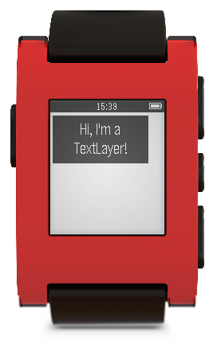
Text Layer
Simple layer that provides functions to write and erase text
Can set text color, font, background color, text alignment…
Simplest Layer

Slide 24
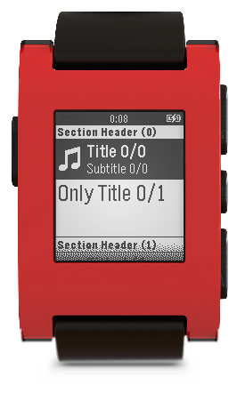
Menu Layer
Layer which defines a familiar menu layout
Each cell can have its data altered
Heavy to setup, minimum of about 5 callback functions
Little interaction required afterwards (unless you’re doing something tricky)

Slide 25
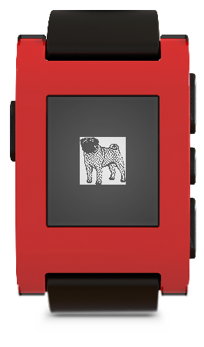
Bitmap Layer
Used to display a picture
Good for icons and simple figures, no HD pictures…

Slide 26
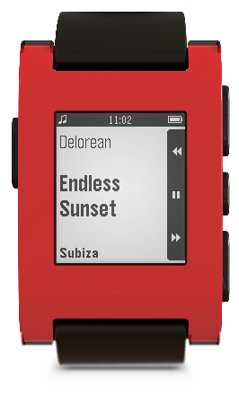
Action Bar Layer
Layer providing vertical row of buttons on right side of window
See default music player app on Pebble for an example
Holds 3 customizable icons (i.e. next, prev)
Icons can be swapped out in real-time
ActionBarLayer is bound to the window directly
No intermediary layer
Set click handlers on ActionBar not window
Additional Layers may cover up ActionBar

Slide 27
Persistence on the Pebble
Storage space is identified by the (hopefully) unique app UUID
Values are all stored in key, value pairs
Keys are uint32_t values
Values are integers, c-strings (char *), and byte arrays
structs can be saved as byte arrays too!
Maximum storage space for any single app is 256 bytes
Calls to Persistence API are slow
best used in the init() and deinit() functions
Notes:
Should reach at about 4:20

Slide 28
Persistence Function Calls
Writing
persist_write_bool(BOOL_KEY_VALUE, true/false);
persist_write_int(INT_KEY_VALUE, 42);
persist_write_string(STRING_KEY_VALUE, “Douglas”);
uint8_t bytes[42]; persist_write_data(BYTES_KEY_VALUE, bytes, sizeof(bytes));
Reading
bool truth = persist_read_bool(BOOL_KEY_VALUE);
char username[20] persist_read_string(STRING_KEY_VALUE);
uint8_t bytes[42]; persist_read_data(BYTES_KEY_VALUE, bytes, sizeof(bytes));
Existence
bool exists = persist_exists(QUESTIONABLE_KEY);

Slide 29
@Override
protected void onCreate(Bundle savedInstanceState) {
super.onCreate(savedInstanceState);
setContentView(R.layout.activity_main);
TextView txt1= (TextView)findViewById(R.id.textView1);
if(connected) txt1.setText("connected");
}
boolean connected = PebbleKit.isWatchConnected(getApplicationContext());
Log.i(getLocalClassName(), "Pebble is " + (connected ? "connected" : "not connected"));

Slide 30
Pebble Device Communication
Communication can be initiated from device or the Pebble
Phone companion app must have the unique UUID of the app to communicate with it
All data must be sent as a dictionary, in key-value pairs
Two packages to use for communication:
AppMessage
AppSync
Additional data structures provided on both Pebble and Android
PebbleDictionary
Tuple
Tuplet

Slide 31
Pebble Communication with AppMessage
Allows high level of control over each individual message
Must implement at most 4 callback functions
Sending
Write values to Dictionary and call “app_message_outbox_send()”
Receiving
void in_received_handler(DictionaryIterator *iter, void *context)
In body check for fields you are expecting to receive with:
dict_find(DictionaryIterator *iter, int id)
Older firmware (1.1) doesn’t support AppMessage

Slide 32
Android Communication with AppMessage
Import PEBBLE_KIT project in to Eclipse and add to Build Path of Android apps
Receiving Messages
registerReceivedDataHandler
One function to implement:
void receiveData(final Context, final int transactionId, final PebbleDictionary)
Must acknowledge receipt of message (or NACK it)
PebbleKit.sendAckToPebble(final Context context, final int transactionId);
Sending Messages
sendDataToPebble(final Context, final UUID, final PebbleDictionary)
Status Updates
Listen for watch connected event
Listen for ACK/NACK messages from the Pebble

Slide 33
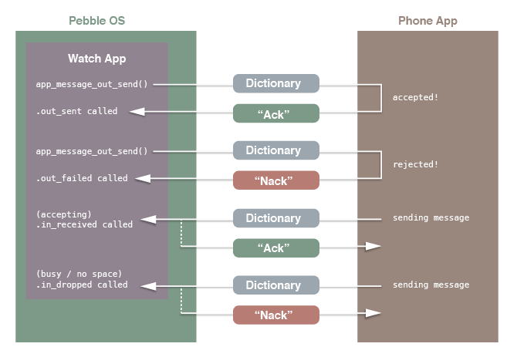
Pebble Communication with AppMessage

Slide 34
Pebble Communication with AppSync
Built on top of AppMessage
Maintains and updates a single Dictionary
Has built-in listeners to automatically update UI elements when the Dictionary changes
Good for applications involving many updates
No user-incurred synchronization costs
Setup one callback, call a setup function, done!

Slide 35
Pebble Communication with AppSync
Setup sync listeners and callbacks
app_sync_init(
struct AppSync *s, uint8_t *buffer, const uint16_t buffer_size, const Tuplet *const keys_and_initial_values, const uint8_t count, AppSyncTupleChangedCallback tuple_changed_callback, AppSyncErrorCallback error_callback, void *context)
Sync_tuple_changed_callback( const uint32_t key, const Tuple *new_tuple, const Tuple *old_tuple, void *context)

Slide 36
Android Communication with AppSync
Exactly the same as AppMessage

Slide 37
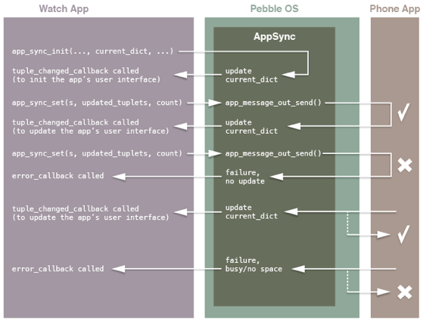
Pebble Communication with AppSync

Slide 38
Javascript Aided Communication
Platform independent way to communicate with Pebble
Interface to make HTTP requests
Turns phone into a server where your Pebble is the client
Interface from phone to Pebble using “Pebble” Javascript object
Interface with the web using Javascript function calls
Part of W3C standard
Data sent in Key-Value pairs
Follow JSON specification
To make a Pebble app using Javascript
Create new project with command: pebble new-project --javascript my_js_project

Slide 39
Pebble Accelerometer
Very sensitive
Sensitive enough to detects taps on the phone
Measured in milli-Gs
Has a range of -4000 to 4000
Watch vibrations affect accelerometer readings
Grabs struct with x, y, z, bool did_vibrate indicating whether vibration occurred while grabbing values and timestamp in milliseconds

Slide 40
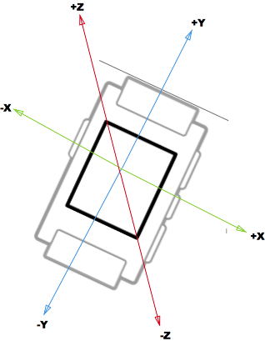
Pebble Accelerometer Axes

Slide 41
Using the Pebble Accelerometer
Three main ways to utilize accelerometer
Register for shake or tap events
Predefined standards for taps and shakes
Process data in batch jobs to analyze for patterns
Can automatically poll for data at predefined intervals
Real time data usage
Easy to subscribe to services for all three

Slide 42
JSON Configuration File
JSON file in root directory of project (settings on CloudPebble)
Includes various values, most are pre-generated
App Kind (watch app, watch face, companion app)
Long Name
Short Name
Menu Image
Version Code
Version Label
App UUID
Also define Javascript Message Keys (if desired)

Slide 43
Pebble Development Setup
Must be running Ubuntu (other Linux distros won’t work out of box)
Download SDK and follow the instructions:
https://developer.getpebble.com/2/getting-started/linux/
There may also be some Python dependencies that are necessary to download using apt-get
All project activities (create, build, install, etc) are issued using the “pebble” terminal utility
To test that you have configured this correctly run:
pebble new-project hello_world

Slide 44
Pebble Development
Create a new project:
pebble new-project <project-name>
Build project code:
pebble build (run inside the project directory)
Install to Pebble watch:
Connect phone and computer to the same Wi-Fi
Get IP Address from Pebble watch companion app
pebble install --phone <ip-address of phone>
Debug code running on Pebble:
To print debug messages add calls to the function below to your code
void app_log(uint8_t log_level, const char *src_filename, int src_line_number, const char *fmt, …)
pebble debug --phone <ip-address of phone>
This will stream print statements initiated by app_log to the terminal

Slide 45
Uploading to the Pebble App Store
Create various graphics to include with your app
To upload your Pebble app to the market you need a minimal of 4 graphics for:
Large Icon
Small Icon
Screenshots (at least one)
Header Image (at least one)

Slide 46
Things to Keep in Mind
Memory is valuable, free it as soon as possible, and avoid unnecessary global variables
Although many global variables are necessary
Memory is NOT managed, you must match every _create() function call with a _destroy() function call
The interface to the Pebble is very limited…try to come up with novel ways to input data easily

Slide 47
Downsides
Back button cannot yet be overridden
Feature set still young, 2.0 SDK added persistence, accelerometer access, magnetometer and many other features
Closed-source
Not much memory

Slide 48
Need References?
The online Pebble API is fantastic
https://developer.getpebble.com/2/api-reference/modules.html
When you run pebble new-project <project_name> you get the default hello world Pebble app
Inside the Pebble SDK folder is a folder named Examples which demonstrates most of the functionality of the Pebble watch
PebbleCloud has several example projects you can select from

Slide 49
Homework Preview
Pebble WatchApp + Android Companion App
Must involve communication between the two
Very open ended. You will have to simply use certain fetures.
Must use one of:
Persistence
Accelerometer
Magnetometer

Slide 50
Pebble for project ?
If yes then you can choose not to do the Pebble homework
Your Pebble integration into the term project must conform to the homework specs
Your Pebble integration will be graded separately and the grade will count towards the homework
Yes. Projects that integrate Pebble will get bonus points.

